Slide 1
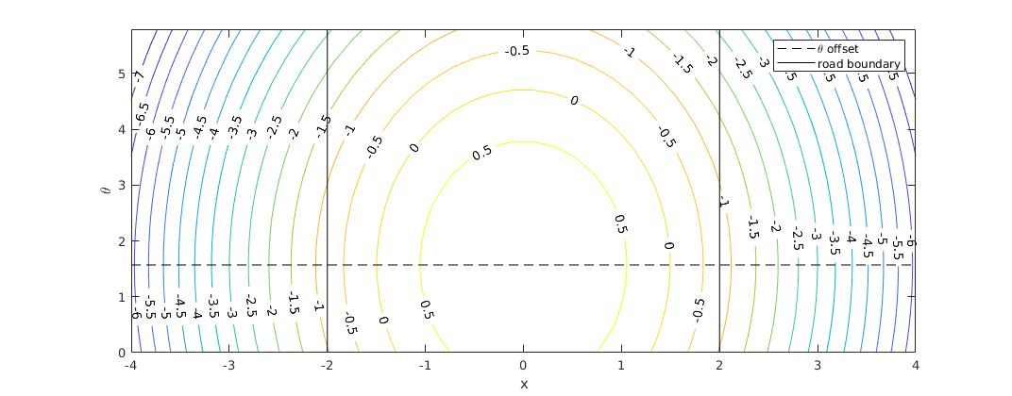
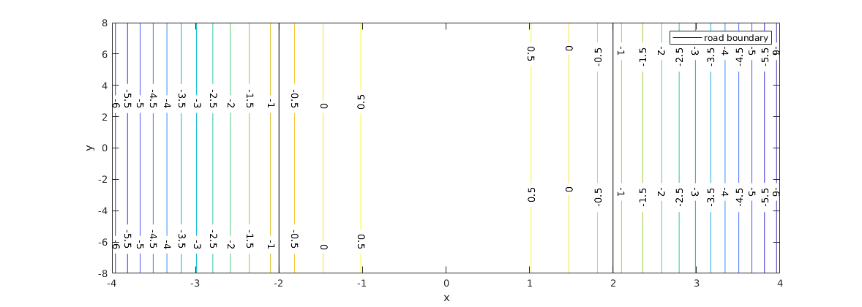
X-theta projection of value function.
Direction of car = theta_offset = pi/2
Width of car = 0.5
1-{(x-x_offset)/((road_width/2)-vehicle_width)}^2-{(th-th_offset)/pi}^2

